Slide 1

Design Your
Business Value Proposition
Template by WKI – wendykennedy.com inc. https://wendykennedy.com
Please modify this template to suit your own style. The topics shown here are what many investors, grant reviewers, and supporters look for you to address – you should decide how best to organize and present this template.
We update this and other templates often - sign up to
receive notices of new templates.
https://wendykennedy.com/design-your-pitch
Good Luck!

Slide 2
Present Your Business Value Proposition
Presentation Template
Title Slide
Include Your Tagline
Company Name & Logo
Team Members
Notes:
Tagline – should be an abbreviated version of your value proposition – not a slogan.
The tagline needs to be the thread throughout this entire presentation – needs to appear in the talking points throughout.

Slide 3
Some Advice Before
You Begin….
Build Your Personality into this Presentation
Your Personal Story Sets the Stage
This is Your Chance to Shine
Make This Template Your Own
Practice, Practice, Practice.

Slide 4
Most Important…
Your pitch needs to be a story and not simply a presentation
Design a theme and storyline that weaves throughout each slide
Add anecdotes and personal stories that engage people and make it personal
Everyone, investors included, remember stories.

Slide 5
Share Your Journey to Now
Where have you been?
What have you done?
  Focus on the cool things
Why are you doing this now?
Include things that are somehow relevant to describe you and your brand

Slide 6
Intro & Vision
Use an image or visual to convey the future. Where are you going? What is your dream? Why are you doing this?
Lead with this as you introduce the team.

Slide 7
The Team
Founding Team
  Credentials
  Track Record – have you done this before?
  Domain experience relevant to this opportunity
    Specifically address the skills related to the idea
    What are the team assets to advance the science/technology?
Advisors
  Mentors, Coaches?
Notes:
This slide can either be used at the beginning of the presentation or towards the end – depending upon your style. If you have strong assets on the team, it might be best to keep close to the front.

Slide 8
The “ASK”
What are you asking for?
What will you use the funding or other support resources to accomplish?

Slide 9
The Business Problem
What’s the real burning business problem?
Validate & Verify the problem is ‘burning’
Bleeding from the neck pain.
How big is the problem?
  Can you put some numbers around it?

Slide 10

The Idea
High level discussion
  Draw your idea on a napkin
  Use plain language your neighbor can understand
  Status of the idea?
    Concept?
    Prototype?
    Patents filed?

Slide 11
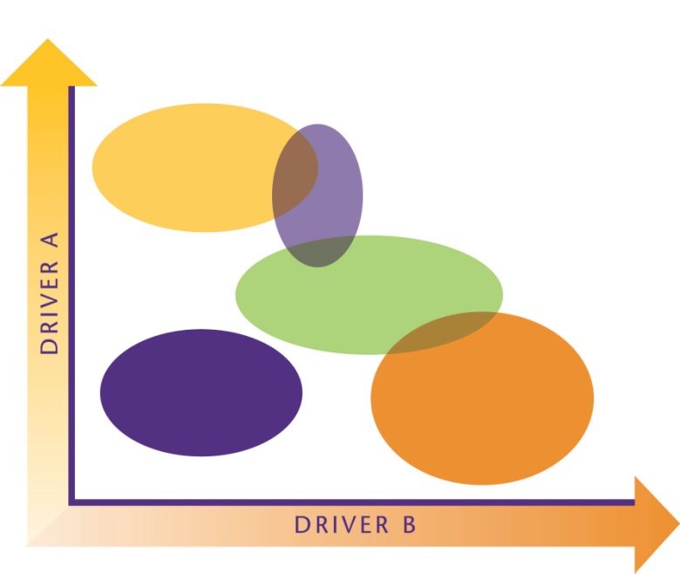
Market Opportunity
What is the market space where this idea fits?
What are the current solutions that exist today?
What’s ‘driving’ this market to open up new white space?
Where is the opportunity for your idea or concept?

Slide 12
Customers
Who has the burning problem?
Who are your target customer segments?
What do you know about these customers?
Who are the decision makers and buyers?

Slide 13
Use Case Scenarios
Paint a picture of how specific customers would use your product
Describe their world and how your idea will solve their problem(s). Use their vocabulary.
Discuss the performance advantage you give to a customer

Slide 14
Competitive Edge
Competitive positioning – what’s your sustainable differentiator?
Who are the current competitors and substitutes?
What is your edge over these alternative solutions?

Slide 15
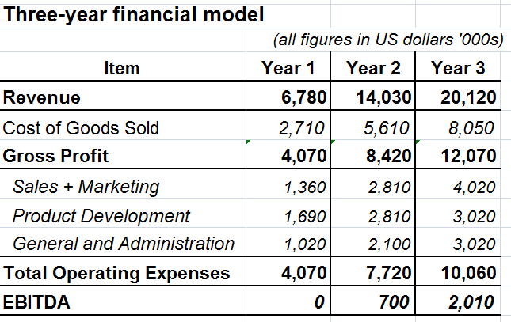
Financial Model
Summarize your three-year financial forecast.
How many customers will you win in years one, two and three?
  How does the revenue scale?
What is the price per unit of your product?
What are your major expenses?
When do you become profitable?
Insert your own summary
Notes:
15

Slide 16
Milestones & Highlights
What have you accomplished to date?
What are the key initiatives to move forward?
Highlight why this is a great business opportunity
  Reinforce proof points from your presentation
  Things like:
    Business Problem
    Market Traction
    Competitive Differentiation

Slide 17
Closing Slide
Tagline
Contact Details

Slide 18

Want help with this template?
WKI’s Design Your Business guides you to build mastery in the key areas of business value and articulate this in a presentation or written document.
Video coaching by Wendy guides you to ideate and design your business value.
Get Started Now: https://wendykennedy.com/dyb

